Slide 1
Q1 2014 CAR Analysis
Team:
Alan Purvey
Julie Heinzinger
Mark Jessen
CAR Number: 133912654
CAR Number: 133911539
CAR Number: 133912730
CAR Number: 133912451

Slide 2
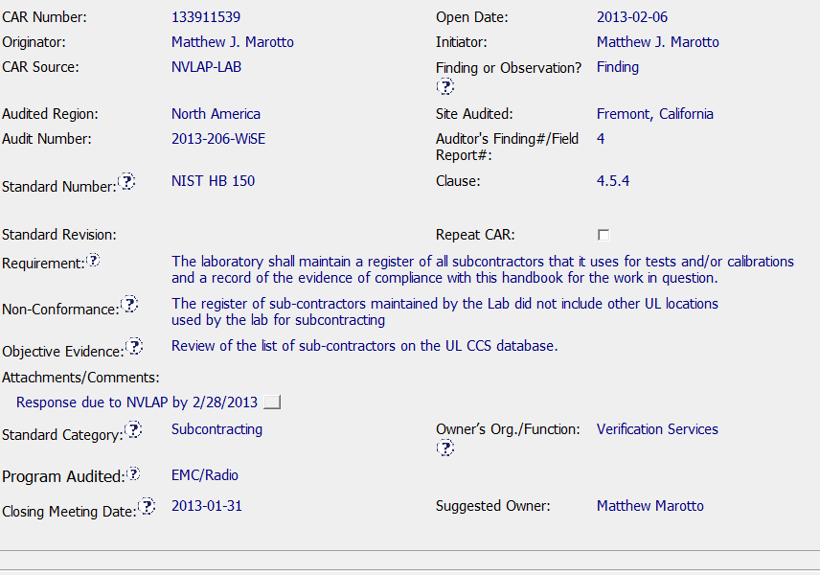
Exemplary CAR 133911539
Requirement matches Non-conformance and Objective
Evidence
Standard category and Program correct
NVLAP response date included

Slide 3
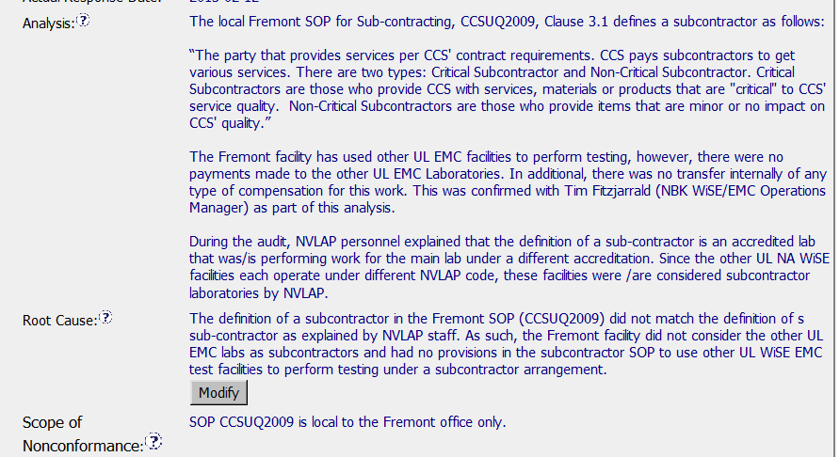
Exemplary CAR 133911539
Analysis identifies stakeholders and determines
Final root cause
Root Cause matches Analysis
Correct Scope of Non-conformance

Slide 4
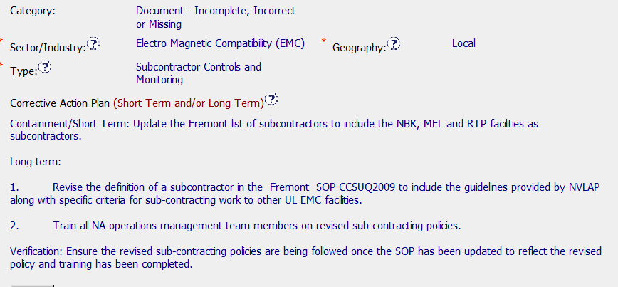
Exemplary CAR 133911539
Category, Sector, Type, Geography
correct
Corrective Action Plan matches Analysis
Containment and Verification addressed

Slide 5
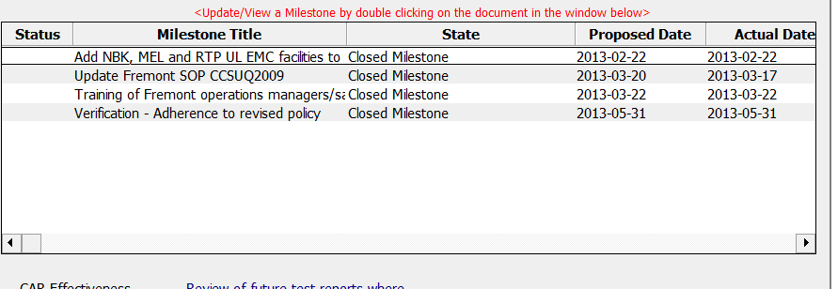
Exemplary CAR 133911539
Milestones match analysis and Corrective Action Plan
Containment and Verification addressed
Appropriate objective evidence attached (SOP, records of training and
Verification record)
Question – Corrective Action Plan states Train all NA operations
management team members – Milestone states Training of Fremont
operations managers/sales managers

Slide 6
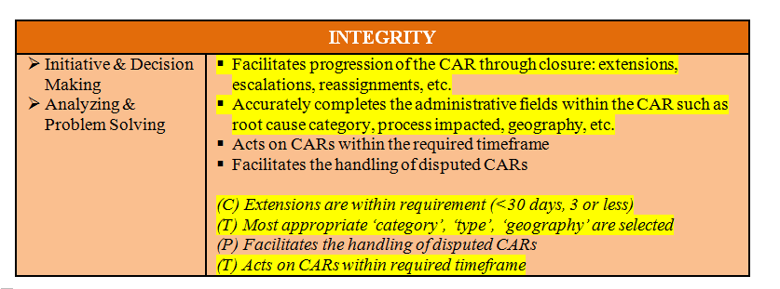
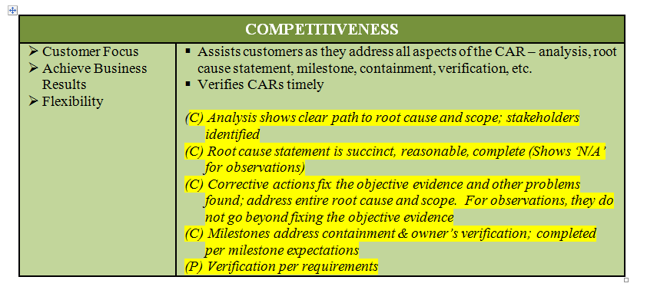
Exemplary CAR 133911539
CBS Met for the following

